Slide 1




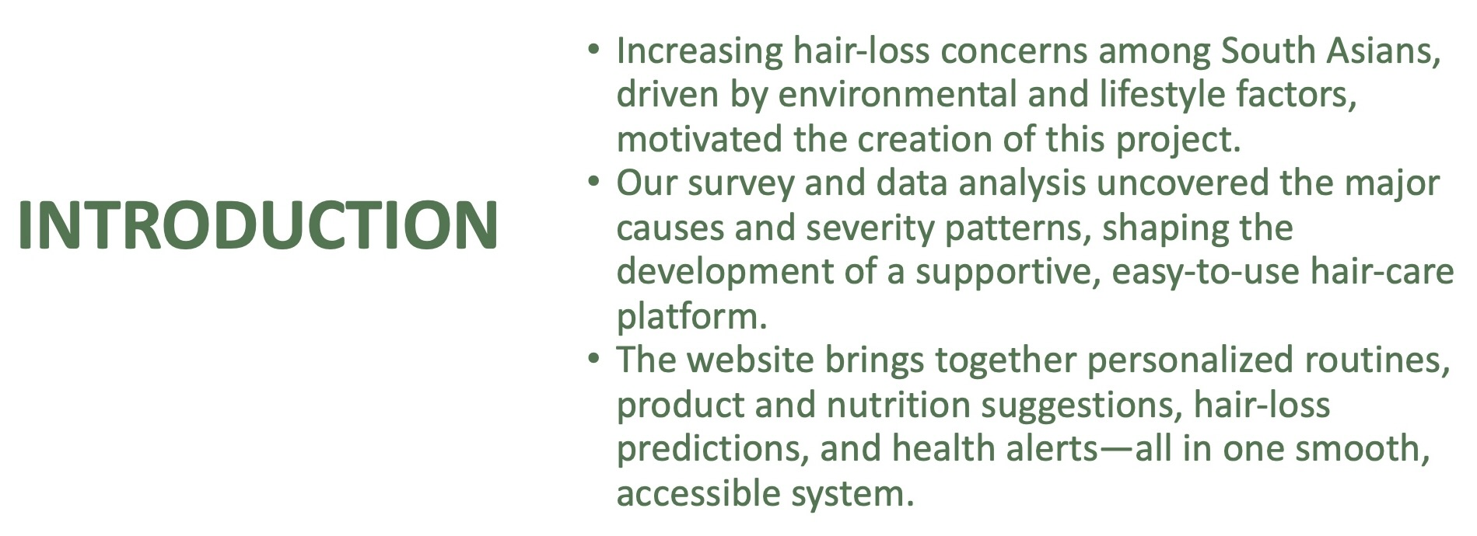
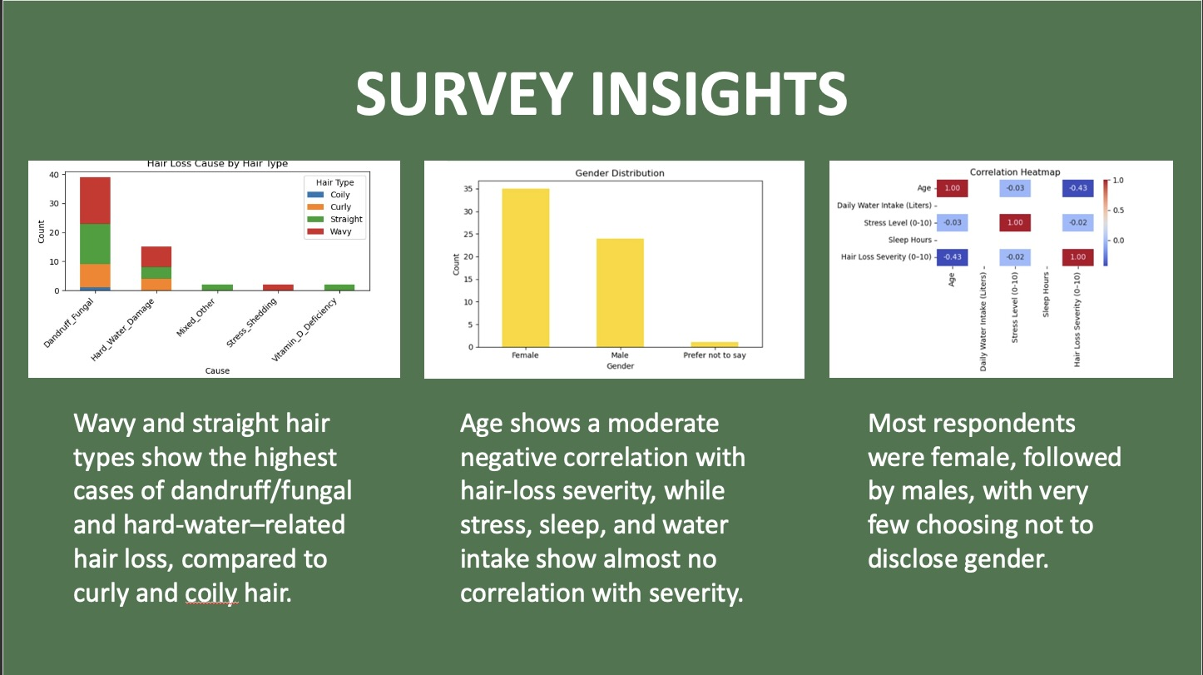
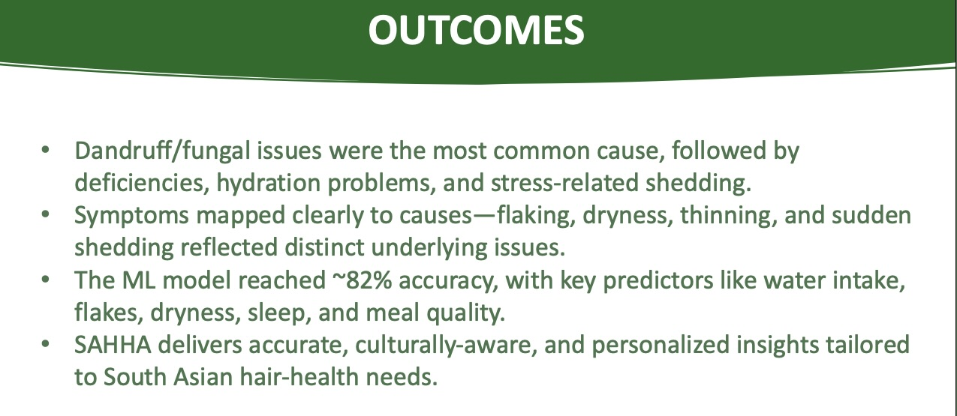
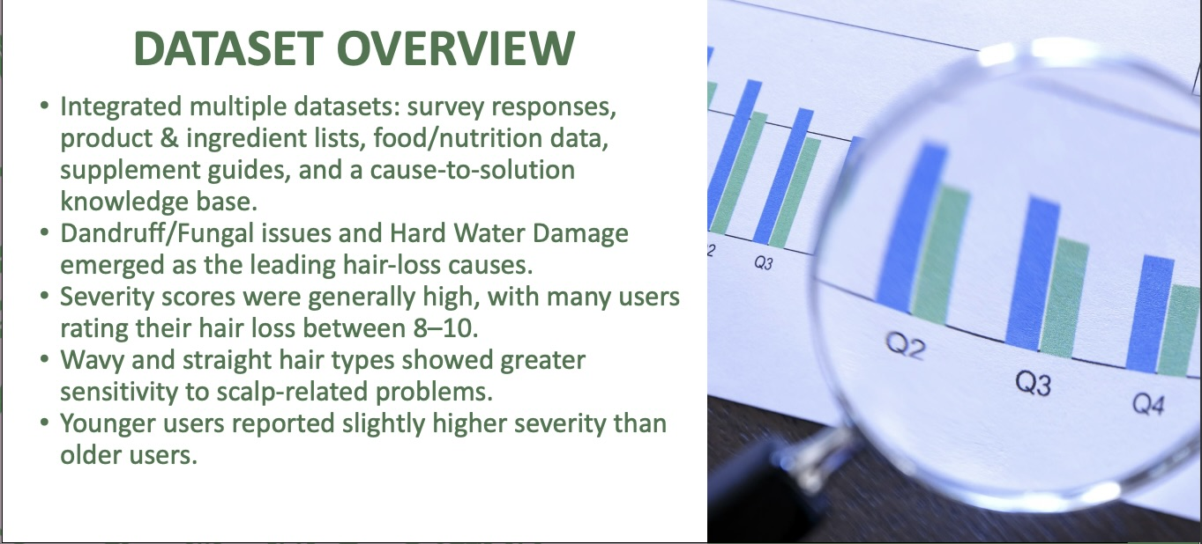
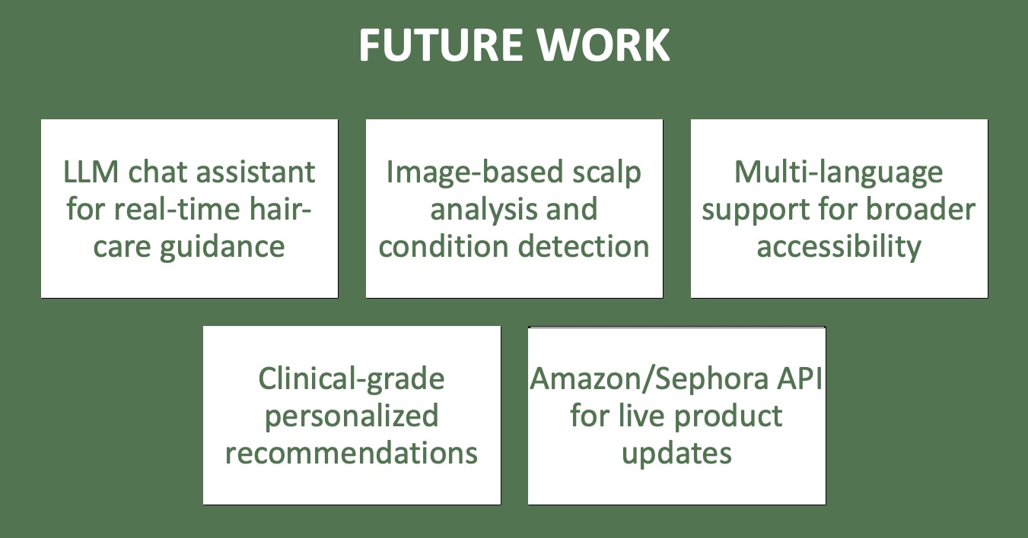
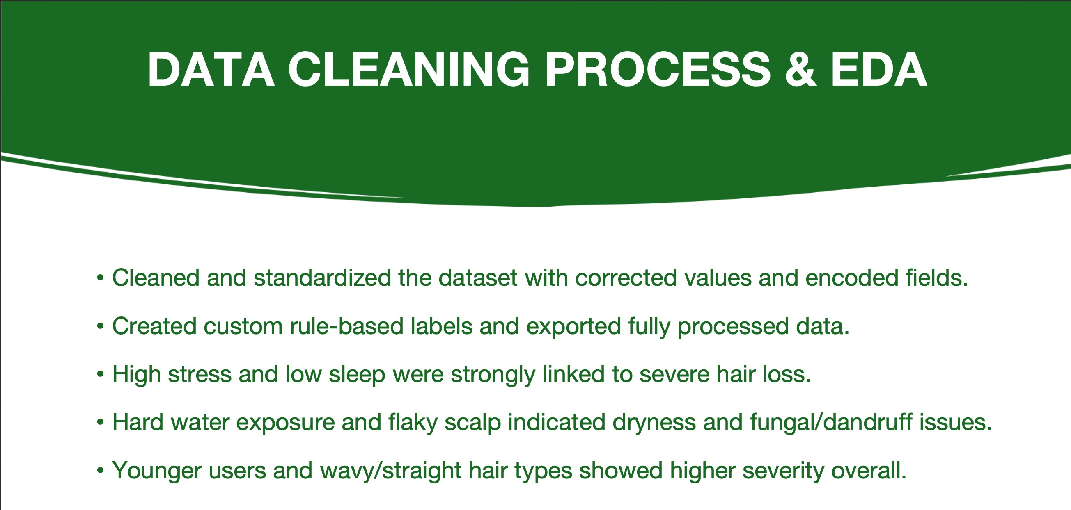
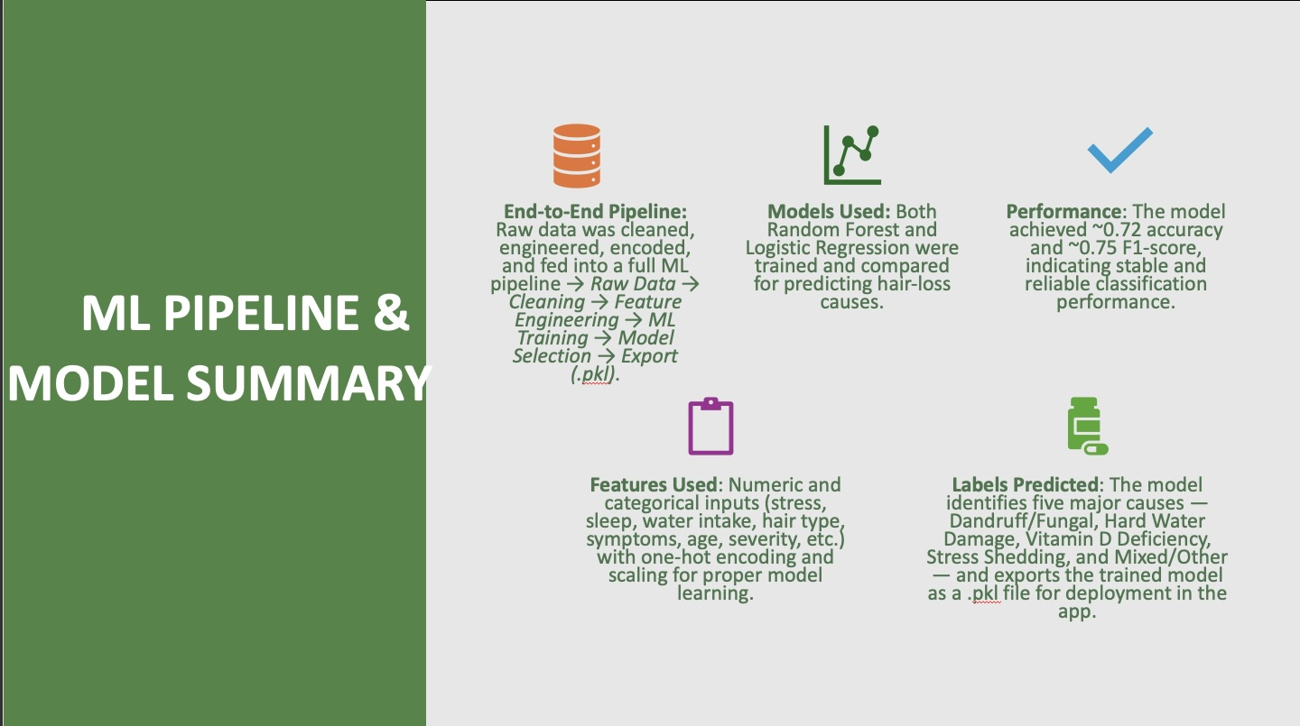
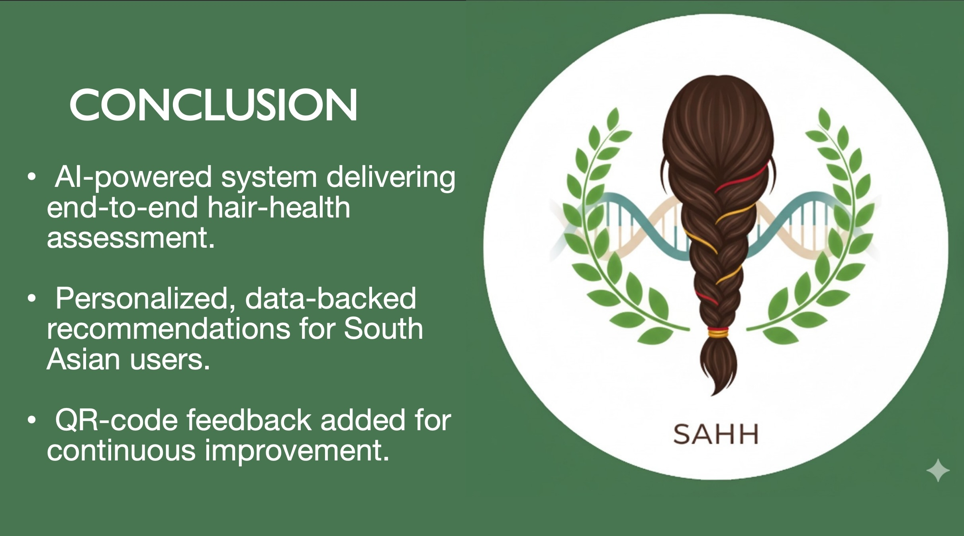
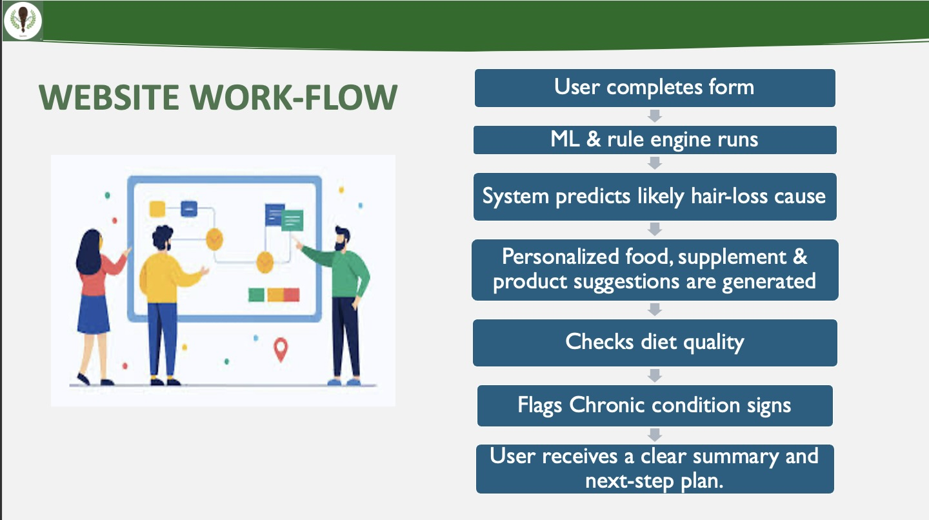

SAHH AI
South Asian Hair Health Assistant
Designed and developed by:
Sirisha Kambam
Email: kambams@mail.sacredheart.edu
Navya Kolluri
Email: kollurin3@mail.sacredheart.edu
Durga sai prasad Ejji
Email: ejjid@mail.sacredheart.edu
Justin Yesudas
Email: yesudasj@mail.sacredheart.edu
Sacred Heart University
SAHH website – scan here

